Slide 1
The Board of Taxation
The Board of Taxation
Karen Payne
CEO and Board Member

Slide 2
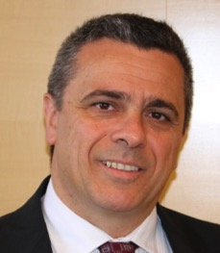
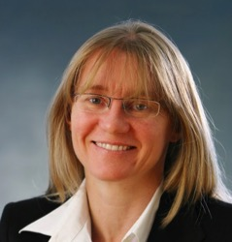
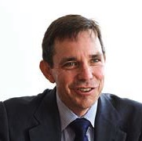
Board of Taxation 2016
Michael Andrew AO (VIC) | John Emerson AM (VIC)
Chair Former global chair, KPMG | Deputy Chair Consultant, Herbert Smith Freehills, Not for profits
Mark Pizzacalla (VIC) | Karen Payne (NSW) | Neville Mitchell (NSW)
Partner-in-charge, Private Clients, BDO | Board Member and CEO Former Partner, Minter Ellison | CFO, Cochlear President, G100

Slide 3
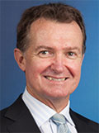
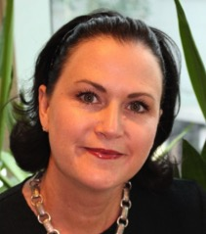
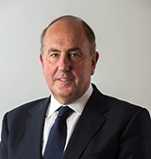
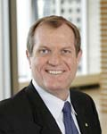
Craig Yaxley (WA) | Ann-Maree Wolff (QLD) | Peggy Lau Flux (SA)
Lead Tax Partner, WA KPMG | Asia Pacific Head of Tax Rio Tinto | Council member Flinders University
John Fraser (ACT) | Chris Jordan AO (NSW) | Peter Quiggin PSM (ACT)
Treasury Secretary (ex-officio) | Commissioner of Taxation (ex-officio) | First Parliamentary Counsel (ex-officio)

Slide 4
Function of the Board
Provide advice to the Minister (currently Minister for Revenue and Financial Services and the Treasurer) on:
Quality and effectiveness of tax legislation including processes for its development and community consultation;
General integrity and function of the tax system;
Research and other studies; and
Other taxation matters.

Slide 5
The Board in Context
Tax Policy & Objectives
Law Design & Integrity
Tax System Improvement
Operation and Simplicity

Slide 6
The Board in Context
Board of Taxation
Treasury
ATO
Industry & Professional Bodies
Business Community

Slide 7
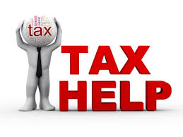
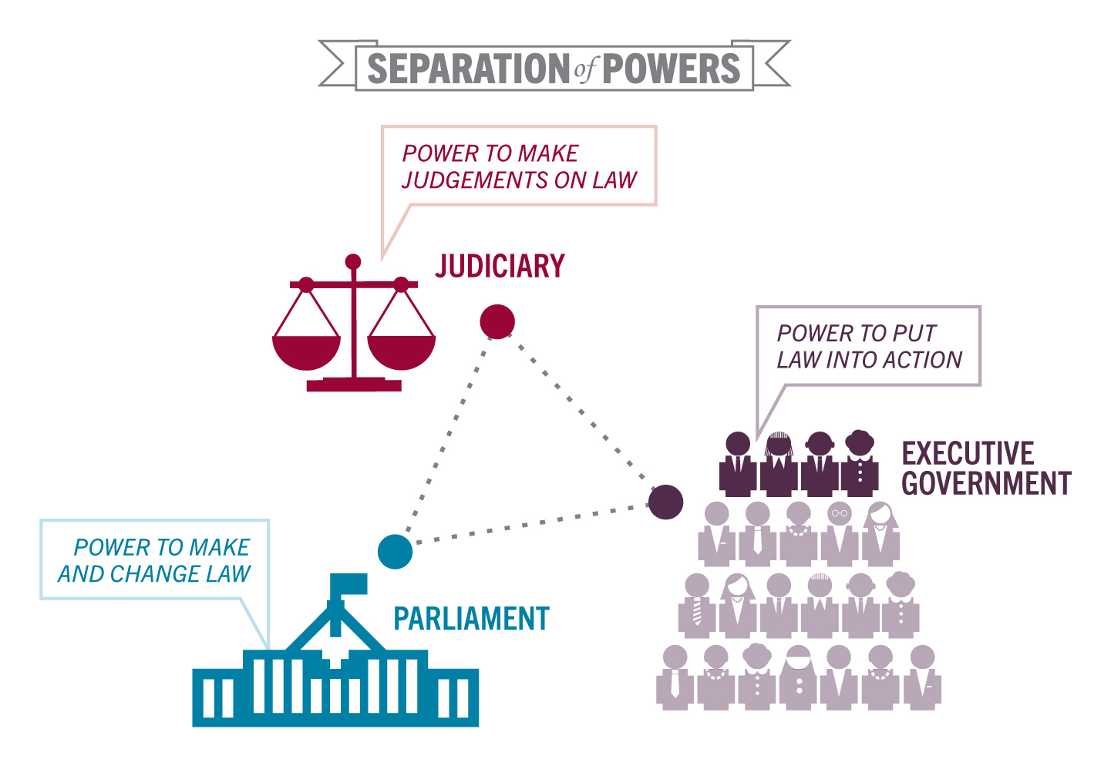
We are an Advisory Board
7

Slide 8
Voluntary Tax Transparency Code
The Board noted that it would like to see a greater take-up of the Code, in particular by private sector companies and foreign multinationals
It is not possible to make direct comparisons between the Board’s register of companies and the ATO’s corporate taxpayer list, since the Voluntary Code is usually prepared to encompass a group of companies which represents many companies on the ATO list. Groups can choose the level of aggregation or grouping of entities for disclosures.

Slide 9
Current state of play
To date, there are 52 organisations indicating their intention to adopt the code.
Last month the CTA resurveyed its membership showing 67 groups (and 95 entities that are listed) have either notified the Board of Tax or are in the process of getting internal approvals for the adoption of the code.
The 67 groups translate to coverage of the following:
67 non-private groups with turnover > $100m
% of total income | % of taxable income | % of tax payable
43% | 64% | 62%

Slide 10
Who Should disclose?
Code outlines recommended disclosures for large and medium businesses
Large business - ‘TTC Australian turnover’ ≥ AUD 500m
Medium business - TTC Australian turnover between AUD 100m and < AUD 500m
Groups can choose the level of aggregation or grouping of entities for disclosures
10

Slide 11
Role of the ATO and AASB
ATO:
Centralised hosting of published TTC reports
ATO will not review accuracy reports
AASB:
Development of guidance material to assist businesses meeting minimum standards
Establishing a common definition of effective tax rate
11

Slide 12
Sounding Board
Raise, debate and prioritise business and community sector ideas on how to improve the tax system
How to keep ideas progressing?
As at 31 October 2016, there are 40 Ideas posted:
The 170+ regulatory reform legacy ideas have been published on the Board’s website.

Slide 13
The Board’s Current Approach
Providing real-time advice across three broad areas:
Policy design
Legislative design
Administration of Australia’s tax system
Notes:
Traditionally, the Board has given effect to its charter by conducting detailed technical and post-implementation reviews on specified aspects of Australia’s tax system.
This would culminate in the provision of a report to Government – sometimes consultations extended over several years. The Government would then consider the Board’s report, and would make a decision to release it to the public along with its response.
The Board’s current approach is to act as a trusted advisor to both Treasury and the Government on tax policy and design.
Our focus is to contribute to ‘real-time’ tax policy issues – which means that Board members are contributing their business experience at a much earlier stage in the policy development process.
The Board will nevertheless continue to be involved in technical and post-implementation reviews as opportunities and terms of reference arise.
However, in this new role, the relationship between the Board and Treasury has strengthened and the Board is providing real-time advice across three broad areas:
Policy design
Legislative design
Administration of Australia’s tax system

Slide 14
Projects
Asset merger roll-over relief
Definitions applied under State and Federal Tax Laws
Stocktake of inconsistencies between core concepts within Federal and State tax laws which are impediments or create barriers for businesses
Alignment of tax and accounting concepts
Targeted areas where the tax law could be aligned to accounting concepts to reduce red tape
14

Slide 15
Projects (cont’d)
Targeted trust simplification
Review of ‘bare trust’ arrangements
High wealth individuals and residency
Review of current residency rules for individuals in light of reports that the rules may be used by some high wealth individuals to avoid tax obligations
Shadow economy
Responses to address tax avoidance through the cash and shadow economy
Tax and the sharing economy
Consider ways in which Australia should tax the sharing economy
15

Slide 16
Projects (cont’d)
Hybrid Mismatch Rules and Regulatory Capital
Finalising Report
Collective Investment Vehicles
Board to provide its response to Minister on Treasury Consultation Paper

Slide 17
How to Keep in Contact
Online:
www.taxboard.gov.au
Sounding Board:
https://taxboard.ideascale.com/
Email:
TaxBoard@treasury.gov.au
Twitter:
@taxboard_au

Slide 18
Questions?
Notes:
Any questions?

