Slide 1
The Board of Taxation
Ann-Maree Wolff
Board Member

Slide 2
Why the Code was developed
Response to community concerns
Expectation large businesses be publicly transparent about their tax affairs.
Drive cultural change within the corporate sector towards greater tax transparency.
Senior management to be actively involved in the decision to adopt the Code
Voluntary in nature to lead to greater and high quality information.

Slide 3
Development process
Board issued with terms of reference
Established working group
Expert panel
Consultation
Submissions
Final Report

Slide 4
Considerations in Developing the Code
Alignment with best practice
Balancing the public interest in increased transparency of tax information with the concerns of some businesses:
compliance costs and regulatory impact;
the impact on the self-assessment system for taxation;
commercial confidentiality;
misunderstanding of published information;
reciprocity — whether other countries will require companies to disclose similar
information under transparency initiatives; and
lack of consistency in transparency initiatives between countries

Slide 5
Potential users of the disclosures
TTC targeted at:
‘General users’ — the ‘person in the street’ and the community at large;
‘Interested users’ — shareholders, analysts, investors, social justice groups,

Slide 6
Who Should disclose?
Code outlines recommended disclosures for large and medium businesses
Large business - ‘TTC Australian turnover’ ≥ AUD 500m
Medium business - TTC Australian turnover between AUD 100m and < AUD 500m
groups can choose the level of aggregation or grouping of entities for disclosures

Slide 7
Disclosures – Part A
Who | Minimum standard of information | How should the content be disclosed?
‘Large’ and ‘medium’ businesses | Reconciliation of accounting profit to tax expense and to income tax paid or income tax payable Identification of material temporary and non-temporary differences Accounting effective company tax rates for Australian and global operations (pursuant to AASB guidance) | Australian general purpose financial statements; or Stand-alone report

Slide 8
Disclosures - Part B
Who | Minimum standard of information | How should the content be disclosed?
‘Large’ businesses | Approach to tax strategy and governance Tax contribution summary for corporate taxes paid Information about international related party dealings | Stand-alone report – eg ‘Taxes paid’ report, CSR report etc

Slide 9
Other matters
Reports should meet a minimum standard of content
Flexibility - no prescribed form or template
Particular circumstances may require further explanation
Assurance
Light touch – audit is optional
Senior management sign off or CFO certification
Organisation should make a concerted effort to meet the spirit of the Code
Commencement
Adopt at earliest opportunity

Slide 10
Voluntary tax transparency code Register
To indicate your organisation’s intention to adopt the Code, simply contact the Board at taxboard@treasury.gov.au
Also tell us the financial year ending from which you intend to adopt the Code

Slide 11
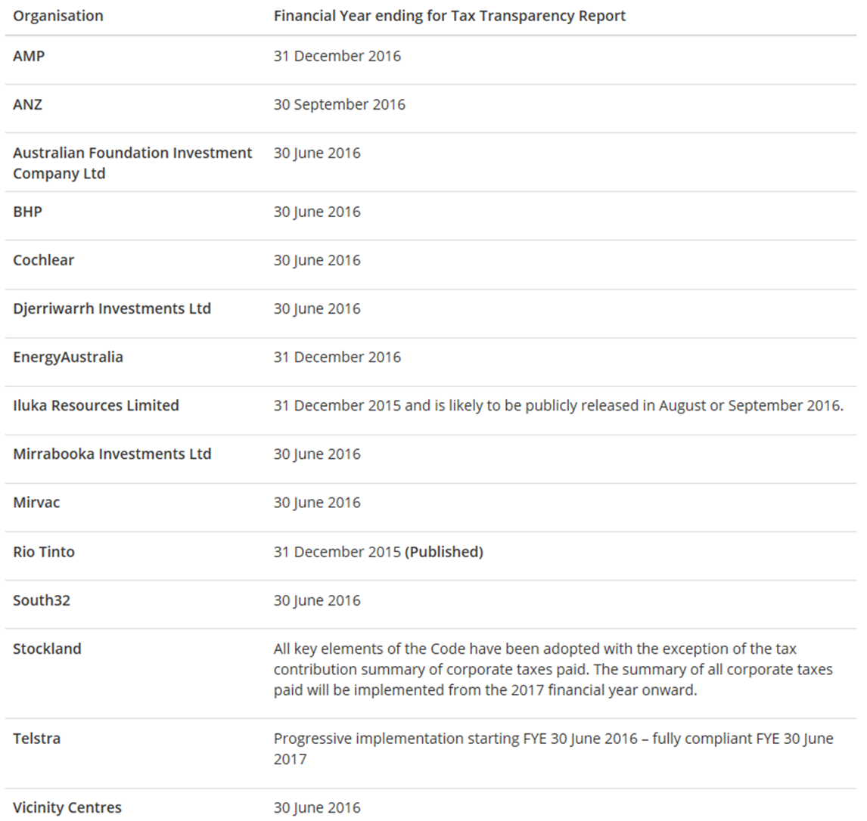
Catalogue of Signatories

Slide 12
Role of the ATO
Centralised hosting of published TTC reports
ATO will not review accuracy reports
Once reports are publicly available – notify the ATO
TTC@ato.gov.au

Slide 13
We want to hear from you!
Online:
www.taxboard.gov.au
Sounding Board:
https://taxboard.ideascale.com/
Email:
TaxBoard@treasury.gov.au
Twitter:
@taxboard_au

Slide 14
Questions?
Notes:
Any questions?

